Slide 1
Scikit-learn
An express introduction

Slide 2












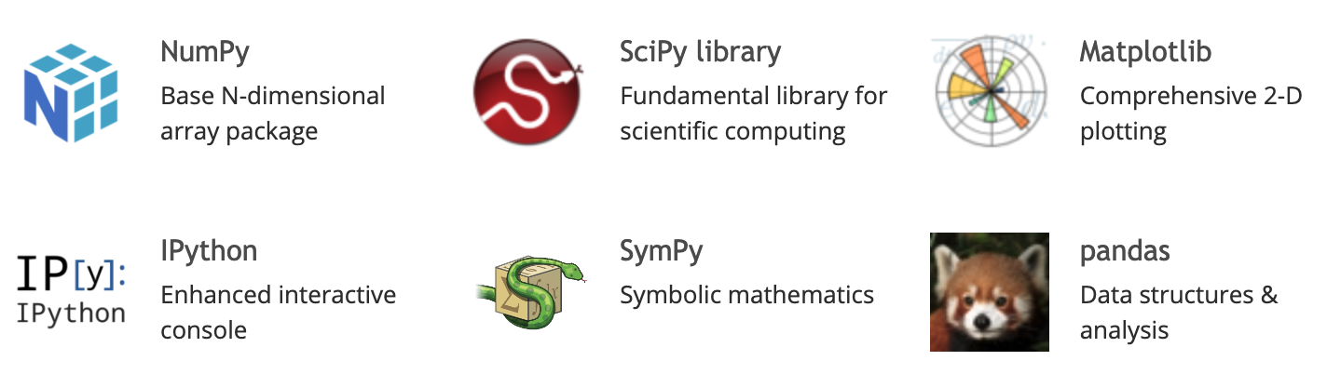

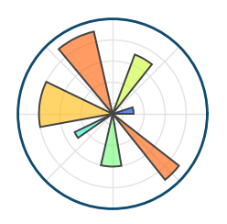






scikit-learn in the Python data science “ecosystem”
Specialised “kits”
Web tools
Core Scientific Python Tools
(https://scientific-python.org/)
Data Visualization
Interactive Environments
Notes:
scikit-learn in the Python data science “constellation”

Slide 3
Why do we care? (and why 9/10 tutorials are pandas + scikit-learn)
Look at the big picture
Get the data
Gain insights
Prepare the data
Select and train
a model
Deploy
HIGHLY ITERATIVE
In machine learning with Python, scikit-learn and pandas are the “glue” that holds pipelines together

Slide 4

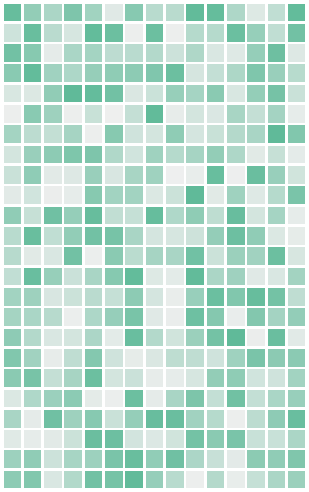
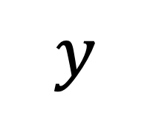


sci-kit core elements: Estimators
Unseen Data
Features
Labels
$$Z$$
$$X$$
$$y$$
samples
Untrained Estimator
Trained Estimator
fit(X,y)
predict(Z)

Slide 5
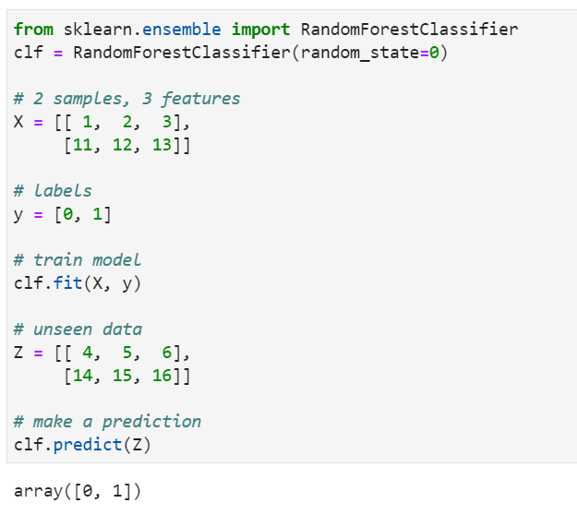
https://scikit-learn.org/stable/getting_started.html

Slide 6
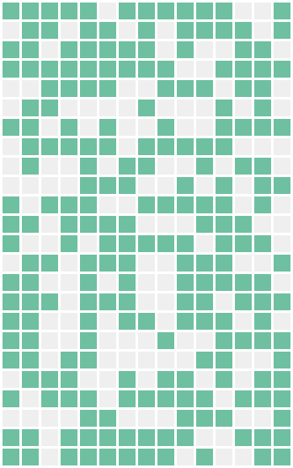
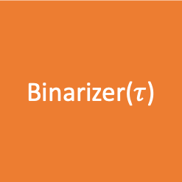
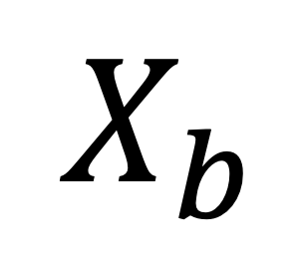
sci-kit core elements: Transformers
Features
Transformed Features
$$X$$
Binarizer($τ$)
$$X_{b}$$
fit_transform(X)
samples

Slide 7
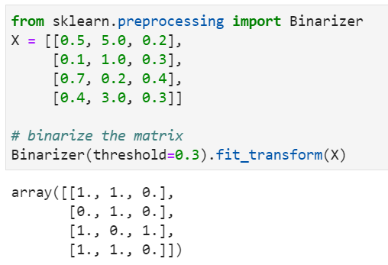

Slide 8
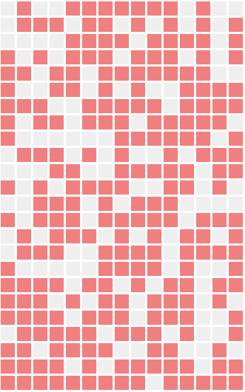
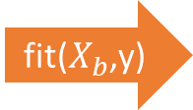

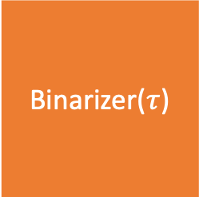
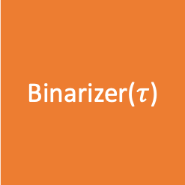


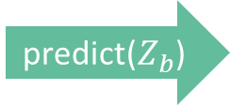

sci-kit core elements: A normal workflow
Features ($X$)
Labels (y)
Untrained Estimator
Trained Estimator
fit($X_{b}$,y)
predict($Z_{b}$)
Transformed Features ($X_{b}$)
Unseen Data ($Z$)
Transformed Data ($Z_{b}$)
Binarizer($τ$)
Binarizer($τ$)
fit_transform(X)
fit_transform(Z)

Slide 9
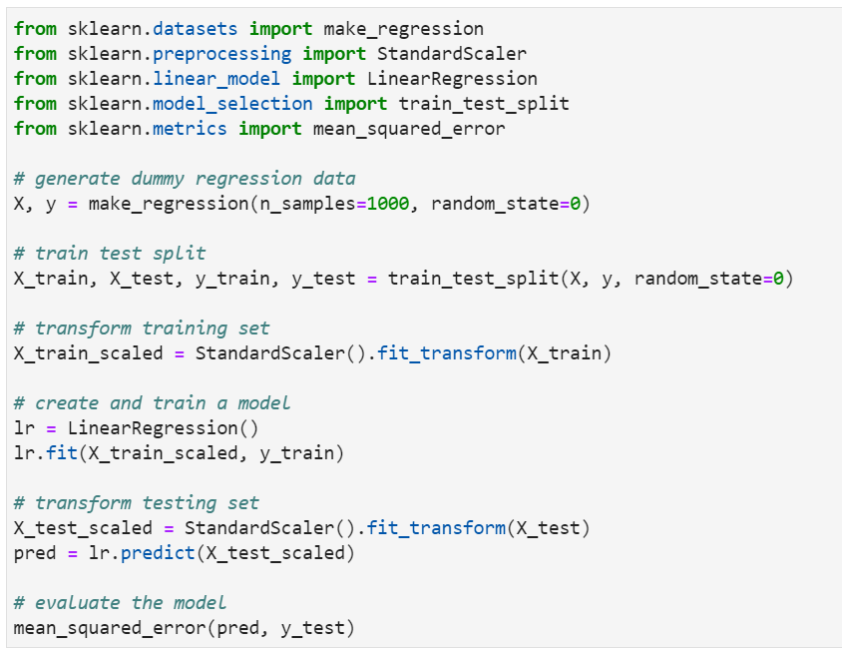

Slide 10



sci-kit core elements: Pipelines
Unseen Data ($Z$)
Features ($X$)
Labels (y)
Untrained Pipeline
Binarizer($τ$)
Untrained Estimator
Trained Pipeline
fit(X,y)
predict(Z)

Slide 11
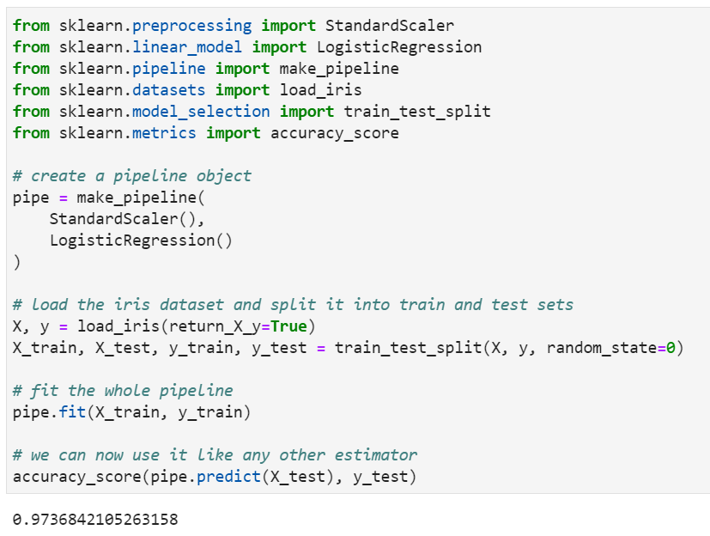

Slide 12
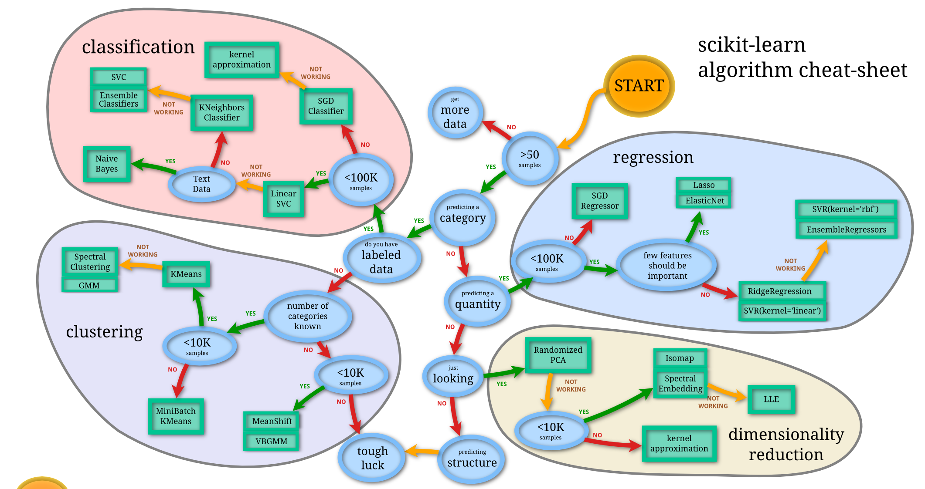
Choosing the right estimator
https://scikit-learn.org/stable/tutorial/machine_learning_map/index.html

Slide 13
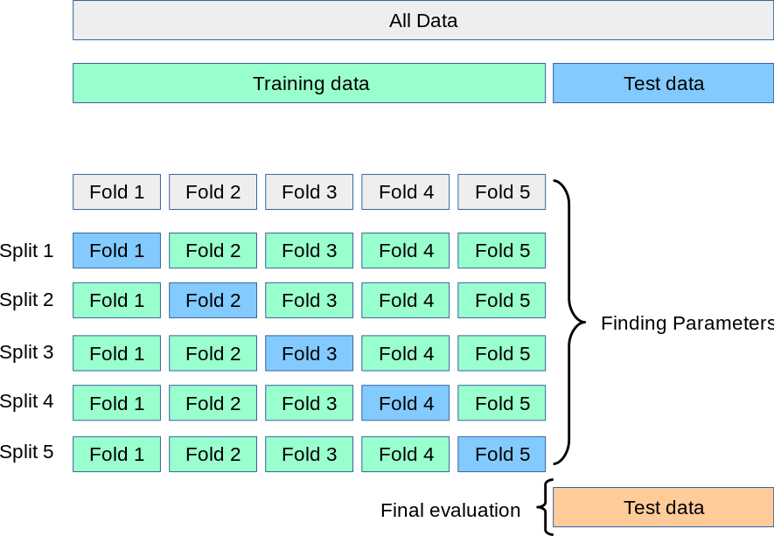
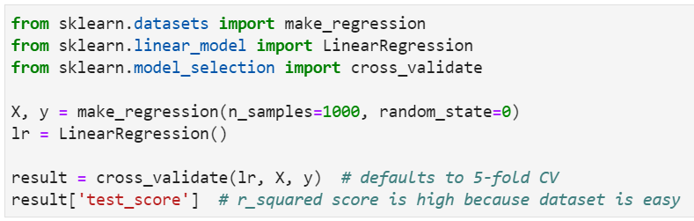
Model Evaluation

Slide 14
Final tips for learning scikit-learn (and any other library)
Read about what it is to determine if it’s worth learning
  Look at how many stackoverflow questions there are
  Does it help you solve the problem you are having?
Follow simple examples and tutorials (often, the official ones are the best ones)
Read the documentation while you use it
READ THE DOCUMENTATION
READ THE DOCUMENTATION!!

